Slide 1

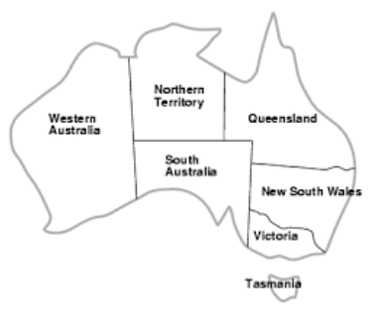
Green University of Bangladesh
Department of Computer Science and Engineering (CSE)
Faculty of Sciences and Engineering
Spring 2024, B.Sc. in CSE (DAY)
Lab Report NO # 05
Course Title: Artificial Intelligence Lab
Course Code: CSE 316 Section: CSE 213 – D1
Problems / Tasks / Domains:
Implement Graph Coloring Algorithm
Use the following map to perform graph coloring algorithm -Hints: convert it into Adjacency List. Write a program to perform graph coloring algorithm which take input as text file from computer.
Student Details
Name | ID
Md. Shahidul Islam Prodhan | 213902017
Lab Assigned Date: 7th May 2024
Submission Date: 14th May 2024
Course Teacher’s Name: Fairuz Shaiara, Lecturer
[For Teacher’s use only: Don’t write anything inside this box]
Lab Report Status
Marks: | Signature:
Comments: | Date:

Slide 2
1. TITLE OF THE LAB REPORT EXPERIMENT
Graph Coloring Algorithm
2. OBJECTIVES/AIM
The primary objective of this project is to implement and analyze a graph coloring algorithm. Specifically, the goals are:
To understand the concept of graph coloring and its applications.
To analyze the efficiency and effectiveness of the implemented algorithm and discuss potential improvements or extensions to the algorithm.
3. PROCEDURE / ANALYSIS / DESIGN
Procedure
Understanding Graph Coloring: Initially, we familiarized ourselves with the concept of graph coloring, which is a fundamental problem in graph theory.
Algorithm Selection: We chose to implement a backtracking-based graph coloring algorithm due to its simplicity and effectiveness for small to medium-sized graphs.
Algorithm Design: We designed the algorithm, considering factors such as vertex ordering, backtracking strategy, and color selection.
Implementation: The algorithm was translated into Python code, following object-oriented design principles to encapsulate graph data and algorithm logic.
Analysis
Complexity Analysis: We analyzed the time complexity of the algorithm in terms of the number of vertices and edges in the graph.
Space Complexity: We examined the space requirements of the algorithm, particularly concerning memory usage.
Performance Considerations: We discussed potential performance bottlenecks and strategies for optimization.
Design
Data Representation: The graph data was represented using an adjacency matrix to facilitate efficient traversal and color assignment.
Modularity: The algorithm was designed as a class to promote code reusability and maintainability.
Input/Output Handling: The algorithm can read graph data from an external file and output the colored graph representation.
4. IMPLEMENTATION
GraphColoring Class: A class encapsulating the graph coloring algorithm, including methods for graph initialization, backtracking, and color assignment.
Input Processing: Reading graph data from an external file and parsing it into the appropriate data structures.
Output Display: Displaying the colored graph representation using the chosen color palette.

Slide 3
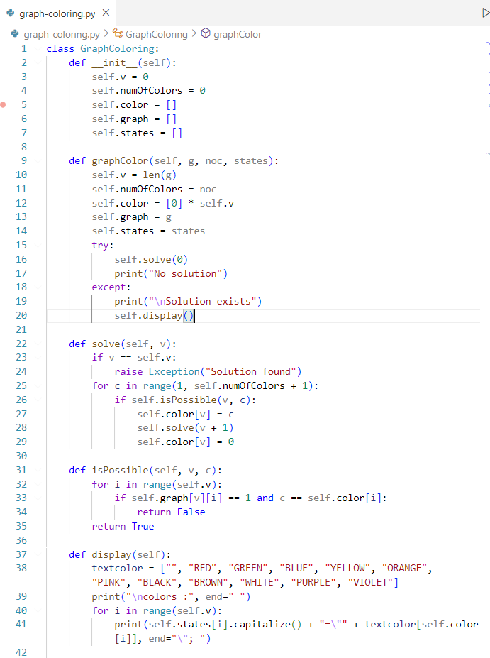
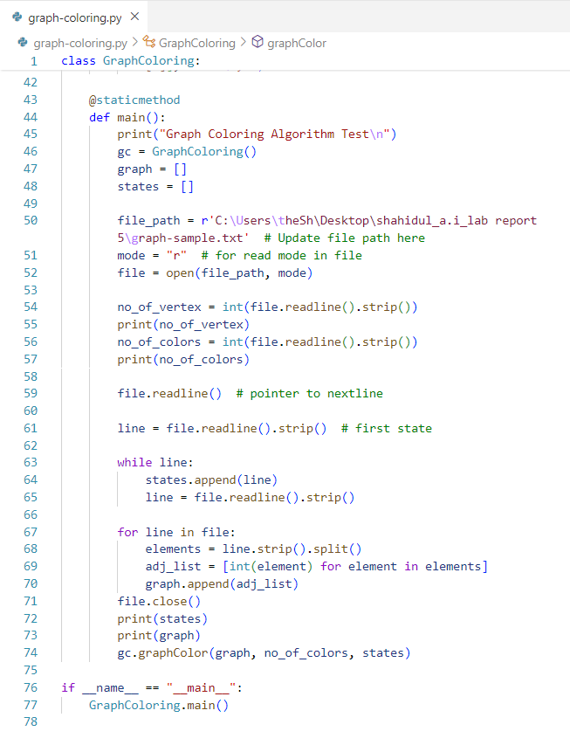
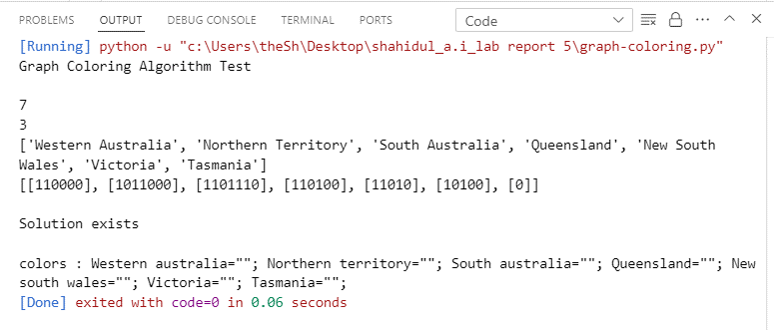
4. IMPLEMENTATION
Code
5. TEST RESULT / OUTPUT

Slide 4
6. ANALYSIS AND DISCUSSION
Here, the implemented backtracking algorithm shows promising efficiency, particularly for small to medium-sized graphs. Its time complexity is influenced by factors such as vertex ordering and the number of colors available, with potential for exponential growth in worst-case scenarios. However, through optimization techniques like intelligent vertex ordering, performance can be significantly enhanced. The algorithm demonstrates effective utilization of space, primarily dependent on memory requirements for storing graph data and color assignments. In terms of solution quality, the algorithm generally produces satisfactory results, though its performance may degrade on larger and denser graphs. Overall, while the algorithm exhibits strengths in efficiency and solution quality for moderate-sized instances, further enhancements could improve its scalability and effectiveness on larger datasets.
7. SUMMARY
In summary, this lab report aimed to implement and analyze a graph coloring algorithm in Python. Through a structured procedure involving understanding, designing, and implementing the algorithm, we achieved the objectives set forth at the outset of the project. The analysis and discussion provided insights into the algorithm's efficiency, effectiveness, and potential areas for improvement. Overall, this project contributes to the understanding and application of graph coloring algorithms in various domains.

